Slide 1
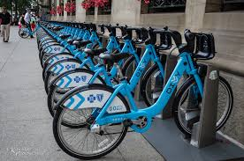
Marketing Strategy to Convert Casual Riders to Annual Members Riders
Cyclistic Bike-Share March, 2023

Slide 2
Solution Design a new Marketing Strategy to convert casual riders into annual members.
Problem:
How to maximizing the number of Annual Memberships

Slide 3
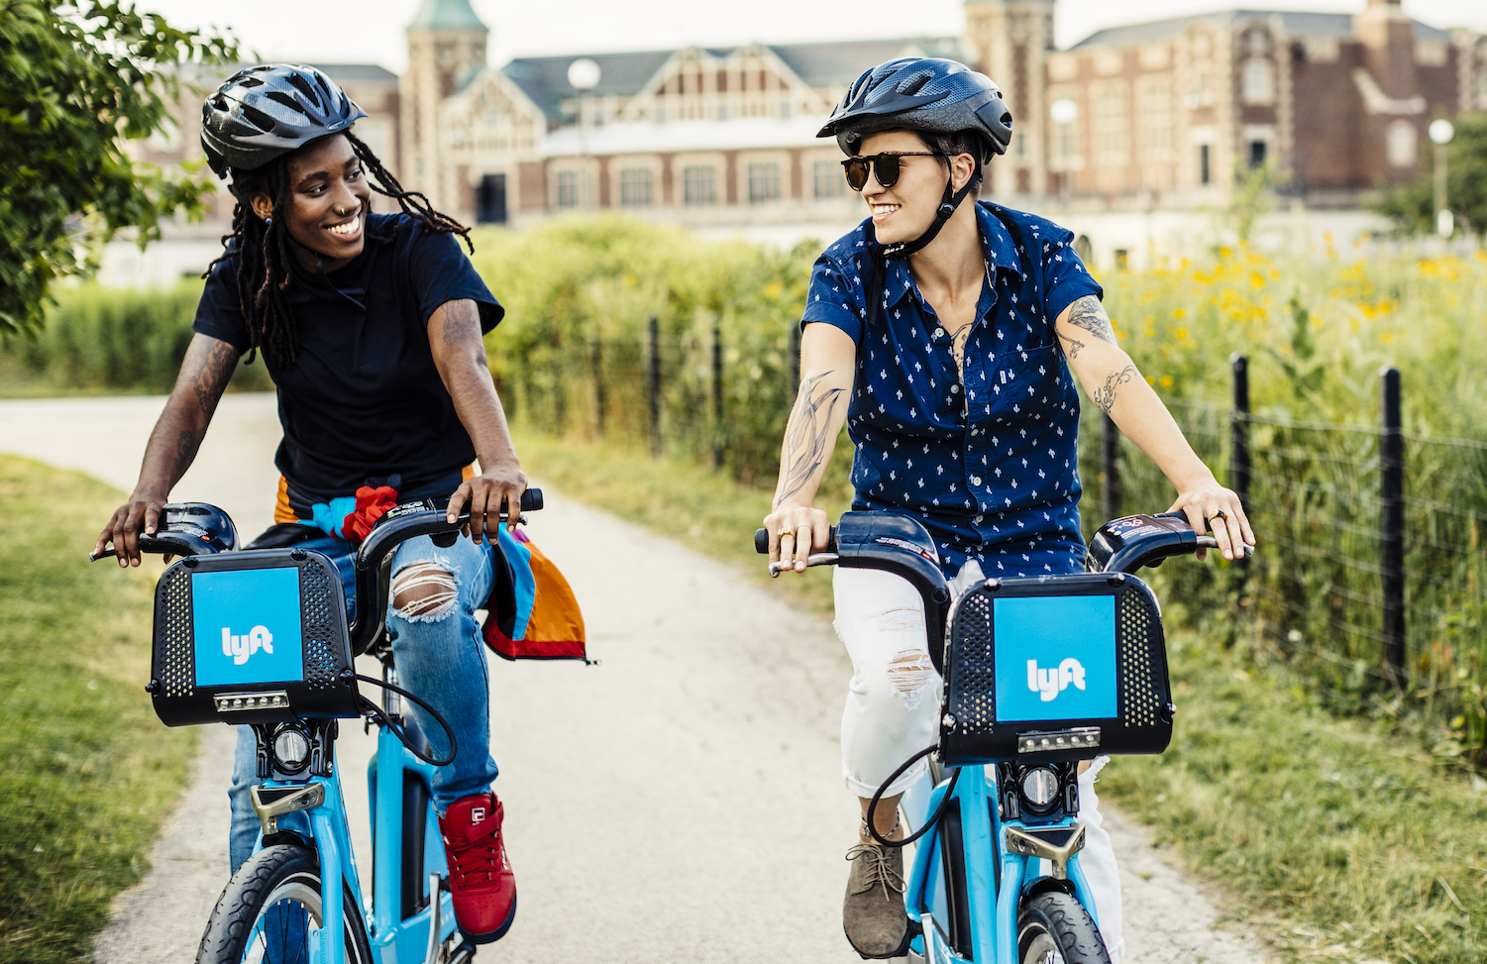
Analytics goal
How do annual members and casual riders use Cyclistic bikes differently?
Why would casual riders buy Cyclistic annual memberships?
How can Cyclistic use digital media to influence casual riders to become members?

Slide 4
Analytics goal
How do annual members and casual riders use Cyclistic bikes differently?
Why would casual riders buy Cyclistic annual memberships?
How can Cyclistic use digital media to influence casual riders to become members?

Slide 5
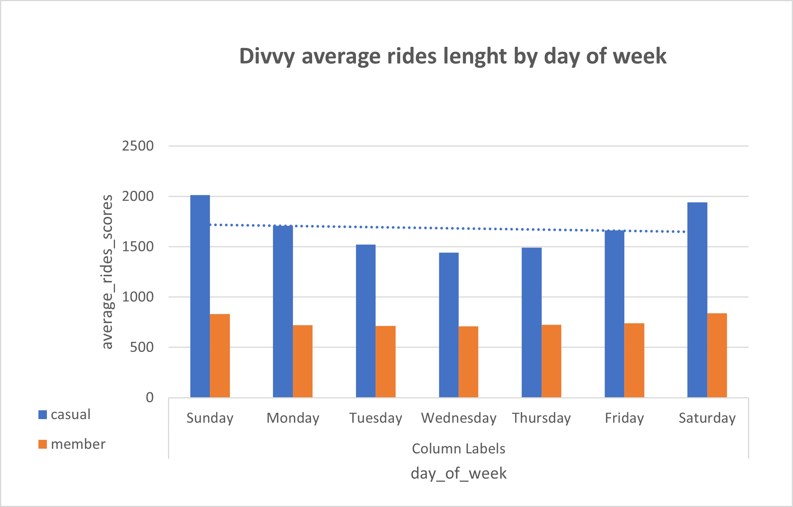
Rides Trend by USERS casual riders ride length have been upward rising through day of week since the last 12 months

Slide 6
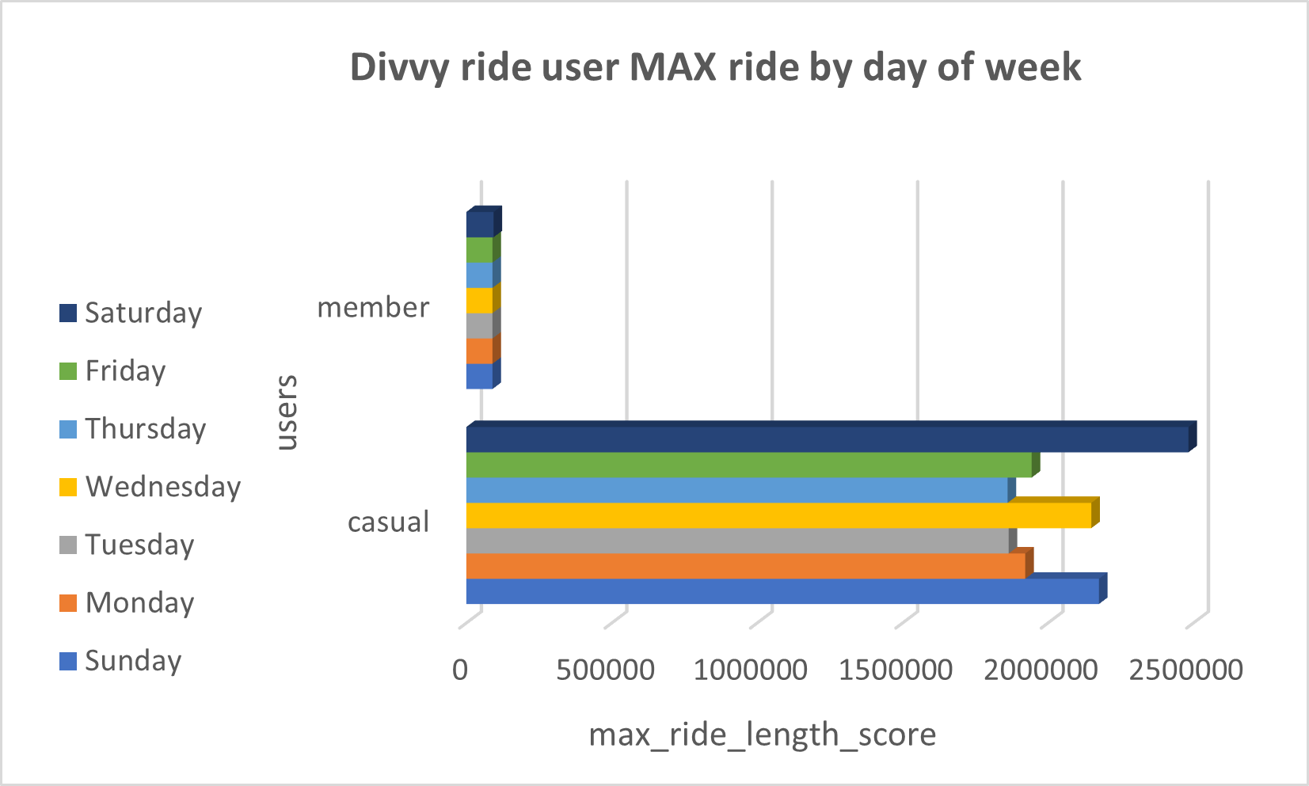
Max Trend
Casual riders versus annual members; MAX trend by weekdays of how ride users use Cyclistic bike differently for the last 12 months

Slide 7
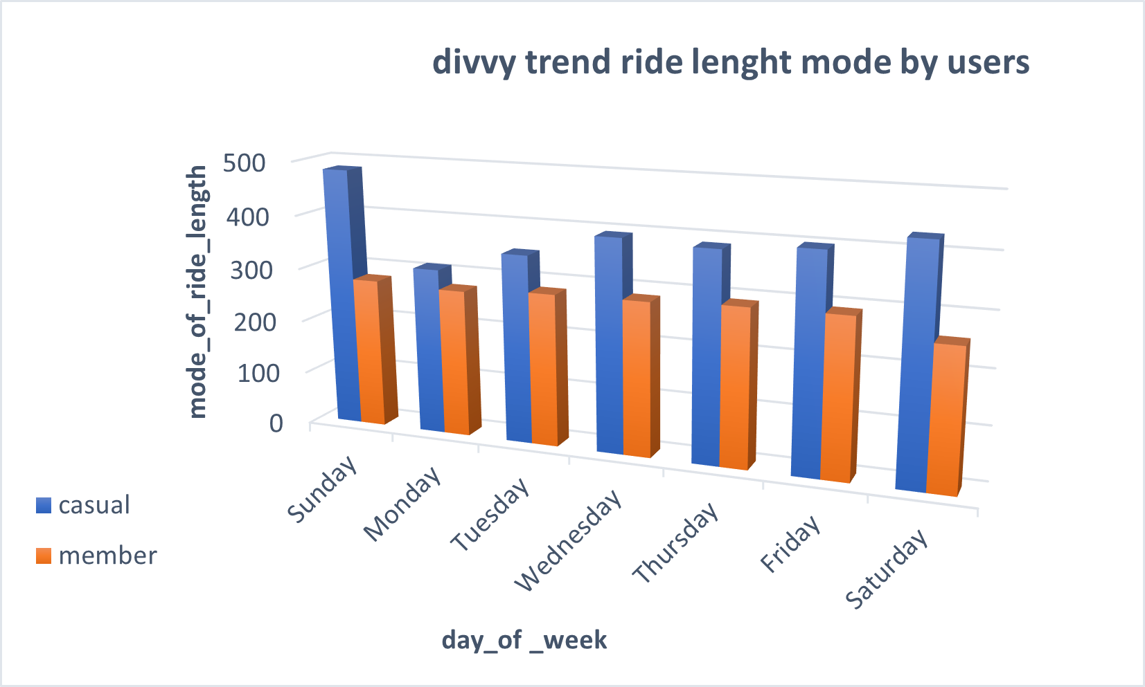
Mode Trend
For the last 12 months, Casual riders uses more time riding Cyclistic bike unlike annual members.

Slide 8
Analytics goal
How do annual members and casual riders use Cyclistic bikes differently?
Why would casual riders buy Cyclistic annual memberships?
How can Cyclistic use digital media to influence casual riders to become members?

Slide 9
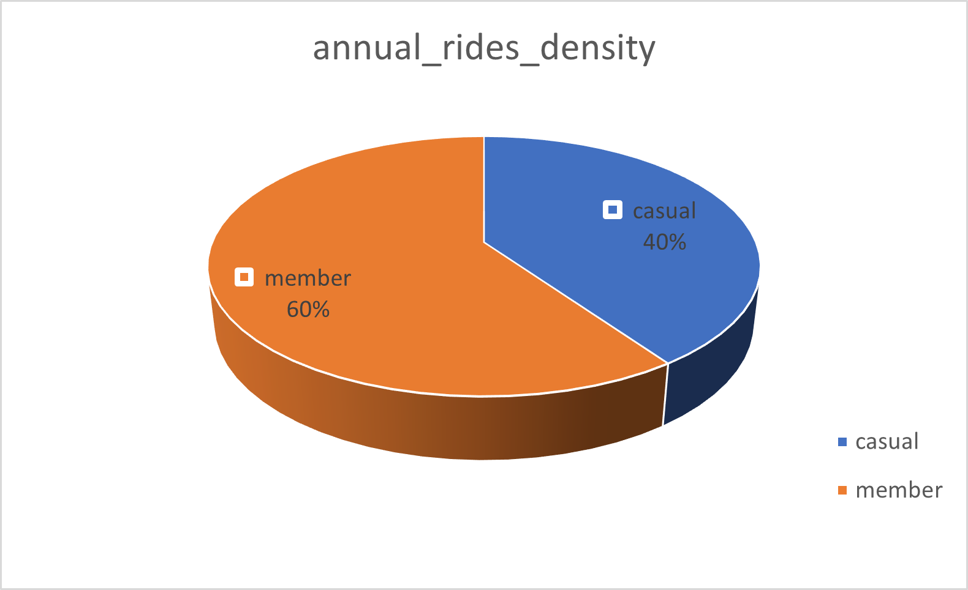
Annual Rides by Riders
Annual members have been rising categorically by percentage since the last previous twelve months

Slide 10
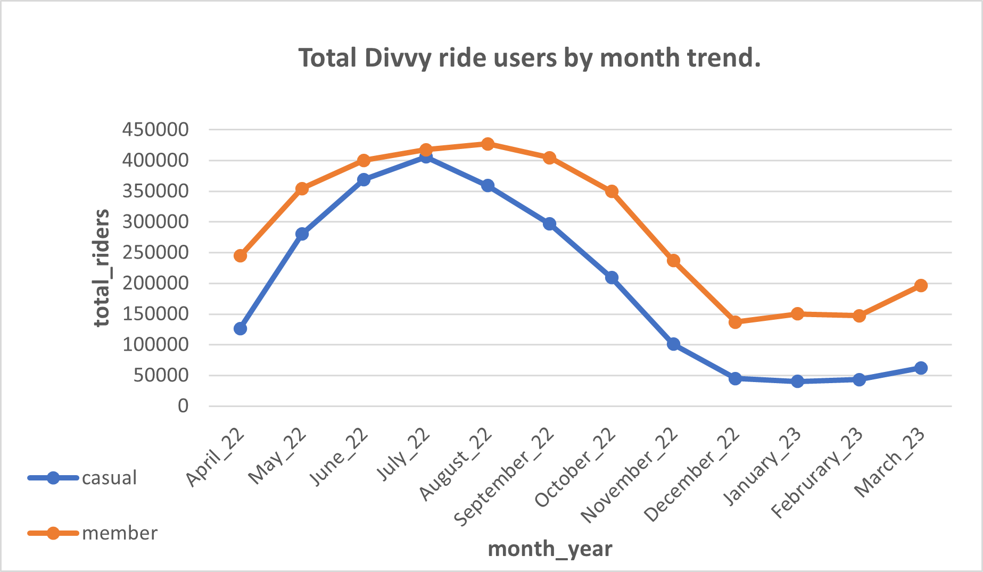
Riders rising trend
Both ride users have been increasing periodically for the last previous twelve months but member most.

Slide 11
Thus, the data trending visualization shows it’s possible to maximizing our annual member by converting casual rider to annual member, both increase in registration for the last twelve months.

Slide 12
Analytics goal
How do annual members and casual riders use Cyclistic bikes differently?
Why would casual riders buy Cyclistic annual memberships?
How can Cyclistic use digital media to influence casual riders to become members?

Slide 13
Digital Marketing Strategies aimed at converting casual riders into annual members.
Run Ads on Digital Media
Run Ads on Mobile App (Divvy App)
Email Marketing
Facebook
Instagram
Mobile SMS Campaign
Mobile App Ads
We must create a pop-up form page as mean of advertisement on our Mobile App.
The Ads algorithm should be programmed to target casual user alone.
Form page should contain annotation of benefit of been a Cylistic member

Slide 14

My Recommendation In summary;
Run an Advertisement on Mobile App directly to Casual riders only, Ads should include benefit of annual member.
Utilize casual rider data generated from the app to digitally reach them with an advertisement to become an annual member
Cyclistic could use digital media to influence casual riders to become members with a pop-up phone on the app, an email marketing, bulk SMS campaign,

Slide 15
Thank you. Data presented by Scorefield Bello. @iamscorefield

